Slide 1

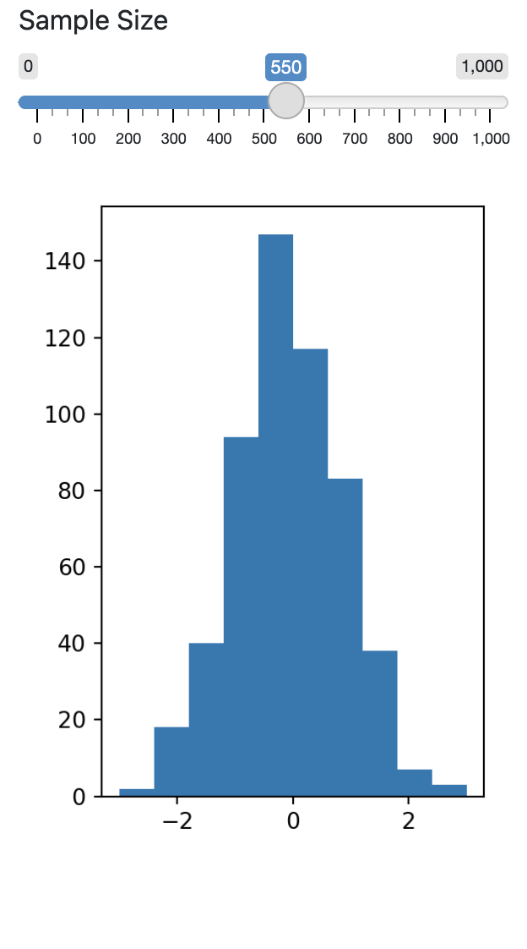
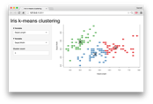
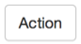
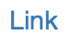
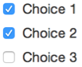
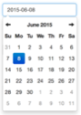


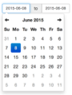
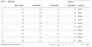
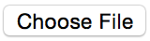
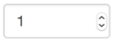

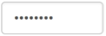
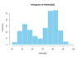
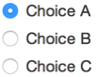
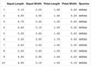
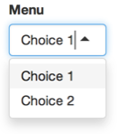
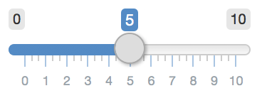
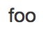
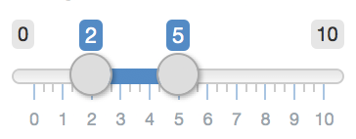
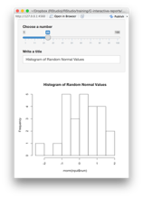
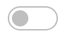
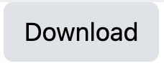
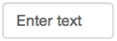

Shiny for Python: : CHEAT SHEET
Build an App
Nest Python functions to build an HTML interface
Run shiny create . in the terminal to generate a template app.py file
Launch apps with
shiny run app.py --reload
Inputs
A Shiny app is an interactive web page (ui) powered by a live Python session run by a server (or by a browser with Shinylive).
Use a ui. function to make an
input widget that saves a value as <id>. Input values are reactive and need to be called as <id>().
Add Inputs with ui.input_*() functions
from shiny import App, render, ui
import matplotlib.pyplot as plt
import numpy as np
app_ui = ui.page_fluid(
ui.input_slider(
"n", "Sample Size", 0, 1000, 20
),
ui.output_plot("dist")
)
def server(input, output, session):
@render.plot
def dist():
x = np.random.randn(input.n())
plt.hist(x, range=[-3, 3])
app = App(app_ui, server)
Layout the UI with Layout Functions
ui.input_action_button(id, label, icon, width, …)
ui.input_action_link(id, label, icon, …)
ui.input_checkbox(id, label, value, width)
ui.input_checkbox_group(id, label, choices, selected, inline, width)
ui.input_date(id, label, value, min, max, format, startview, weekstart, language, width, autoclose, datesdisabled, daysofweekdisabled)
ui.input_date_range(id, label, start, end, min, max, format, startview, weekstart, language, separator, width, autoclose)
ui.input_file(id, label, multiple, accept, width, buttonLabel, placeholder, capture)
ui.input_numeric(id, label, value, min, max, step, width)
ui.input_password(id, label, value, width, placeholder)
ui.input_radio_buttons(id, label, choices, selected, inline, width)
ui.input_select(id, label, choices, selected, multiple, selectize, width, size) Also ui.input_selectize()
ui.input_slider(id, label, min, max, value, step, ticks, animate, width, sep, pre, post, timeFormat, timezone, dragRange)
ui.input_switch(id, label, value, width)
ui.input_text(id, label, value, width, placeholder, autocomplete, spellcheck) Also ui.input_text_area()
Add Outputs with ui.ouput_*() functions
Users can manipulate the UI, which will cause the server to update the UI’s displays (by running Python code).
Save your app as app.py in a directory with the files it uses.
For each output, define a function that generates the output
Specify the type of output with a @render. decorator
app-name
The directory name is the app name.
app.py
Place images, CSS, etc. to share with the browser in a folder named "www."
Call the values of UI inputs with input.<id>()
www/
<other>/
Call App() to combine app_ui and server into an interactive app
Match ui.output_* functions to @render.* decorators to link Python output to the UI.
Share
Shinylive
Outputs
Share your app in three ways:
Shinylive apps use WebAssembly to run entirely in a browser–no need for a special server to run Python.
ui.output_data_frame(id)
@render.data_frame
ui.output_image(id, width, height, click, dblclick, hover, brush, inline)
@render.image
ui.output_plot(id, width, height, click, dblclick, hover, brush, inline)
@render.plot
ui.output_table(id)
@render.table
ui.output_text_verbatim(id, …)
ui.output_text(id, container, inline)
@render.text
ui.output_ui(id, inline, container, …) ui.output_html(id, inline, container, …)
@render.ui
ui.download_button(id, label, icon, …)
@session.download
Host it on shinyapps.io, a cloud based service from Posit. To deploy Shiny apps:
Create a free or professional
account at shinyapps.io
Use the reconnect-python package
to publish with rsconnect deploy
shiny <path to directory>
Purchase Posit Connect, a publishing platform for R and Python.
posit.co/connect
Use open source deployment options
shiny.posit.co/py/docs/deploy.html
Server runs Python
Simple web server
Browsers run self-contained apps
Shiny
Shinylive
Edit and/or host Shinylive apps at shinylive.io
Create a Shinylive version of an app to deploy with
shinylive export myapp site
Then deploy to a hosting site like Github or Netifly
Embed Shinylive apps in Quarto sites, blogs, etc.
---
filters:
- shinylive
---
An embedded Shinylive app:
```{shinylive-python}
#| standalone: true
# [App.py code here…]
```
To embed a Shinylive app
in a Quarto doc, include the bold syntax.
CC BY SA Posit Software, PBC • info@posit.co • posit.co • Learn more at shiny.posit.co/py • HTML cheatsheets at pos.it/cheatsheets • shiny 0.10.2 • Updated: 2024-05

Slide 2
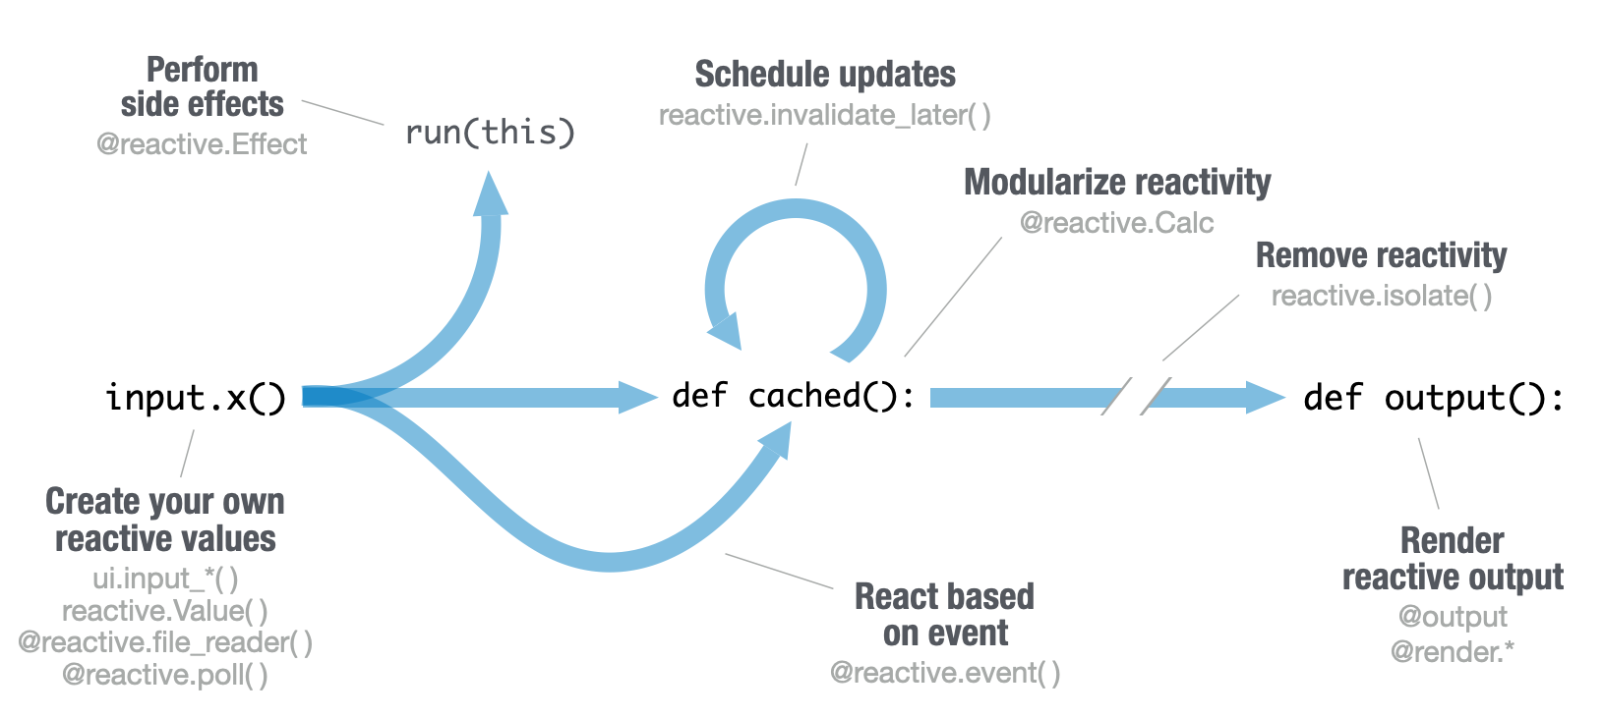
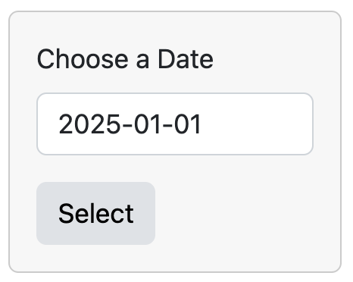

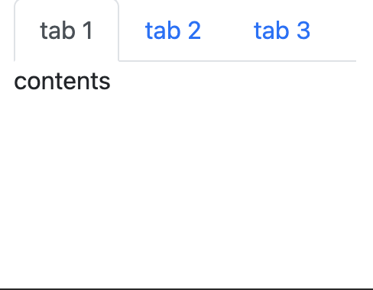
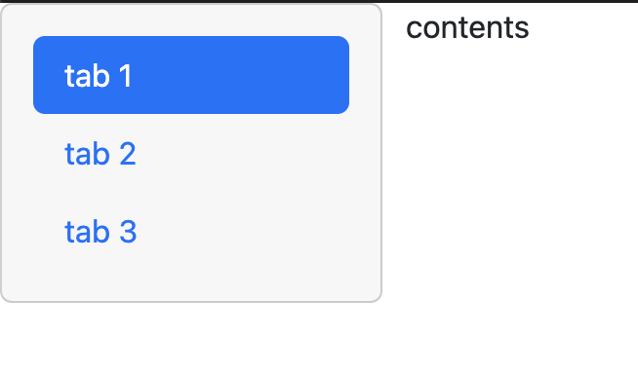
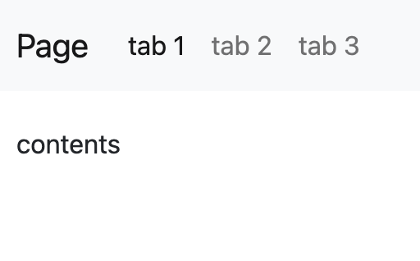
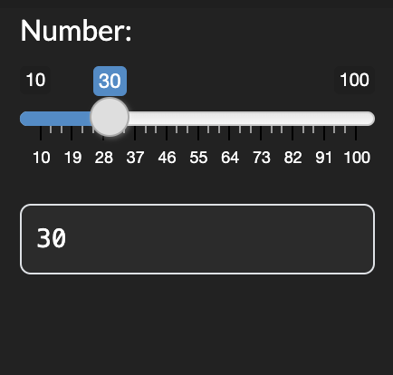
Reactivity
Layouts
Shiny
for R
Comparison
Reactive values work together with reactive functions. Call a reactive value from within the arguments of one of these functions to avoid the error No current reactive context.
Combine multiple elements into a "single element" that has its own properties with a panel function:
ui.panel_absolute()
ui.panel_conditional()
ui.panel_fixed()
ui.panel_main()
ui.panel_sidebar()
ui.panel_title()
ui.panel_well()
ui.row() / ui.column()
Shiny for Python is quite similar to Shiny for
R with a few
important
differences:
ui.panel_well(
ui.input_date(…),
ui.input_action_button(…)
)
1.
Call inputs as input.<id>()
input$x
input.x()
Layout panels with a layout function. Add elements as arguments of the layout functions.
ui.layout_sidebar()
2.
Define outputs as decorated functions def <id>():
output$y <-
renderText(z())
@renderText
def y():
return z()
title panel
app_ui = ui.page_fluid(
ui.panel_title( ),
ui.layout_sidebar(
ui.panel_sidebar( ),
ui.panel_main( ),
))
side
panel
main
panel
CREATE YOUR OWN REACTIVE VALUES
DISPLAY REACTIVE OUTPUT
# …
app_ui = ui.page_fluid(
ui.input_text("a", "A")
)
def server(
input, output, session
):
rv = reactive.Value()
rv.set(5)
# …
ui.input_*() makes an input widget that saves a reactive value as input.<id>().
app_ui = ui.page_fluid(
ui.input_text("a", "A"),
ui.output_text("b"),
)
def server(
input, output, session
):
@render.text
def b():
return input.a()
ui.output_*() adds an output element to the UI.
ui.row()
row
app_ui = ui.page_fluid(
ui.row(
ui.column(width = 4),
ui.column(width = 2, offset = 3),
),
ui.row(ui.column(width = 12)))
3.
To create a reactive expression, use @reactive.calc
z <- reactive({
input$x + 1
})
@reactive.calc
def z():
return input.x()+1
@render.*
Decorator to identify and render outputs
column
col
reactive.value( ) Creates an object whose value you can set.
column
def <id>(): Code to generate the output
Layer ui.nav( )s on top of each other,
and navigate between them, with:
4.
To create an observer, use @reactive.effect
a <- observe({
print(input$x)
})
@reactive.effect
def a():
print(input.x())
CREATE REACTIVE EXPRESSIONS
PERFORM SIDE EFFECTS
ui.page_fluid(ui.navset_tab(
ui.nav("tab 1", "contents"),
ui.nav("tab 2", "contents"),
ui.nav("tab 3", "contents")))
ui.page_fluid(ui.navset_pill_list(
ui.nav("tab 1", "contents"),
ui.nav("tab 2", "contents"),
ui.nav("tab 3", "contents")))
ui.page_navbar(
ui.nav("tab 1", "contents"),
ui.nav("tab 2", "contents"),
ui.nav("tab 3", "contents"),
title = "Page")
# …
def server(
input, output, session
):
@reactive.calc
def re():
return input.a() + input.b()
# …
@reactive.calc Makes a function a reactive expression. Shiny notifies functions that use the expression when it becomes invalidated, triggering recomputation. Shiny caches the value of the expression while it is valid to avoid unnecessary computation.
# …
def server(
input, output, session
):
@reactive.effect
@reactive.event(input.a)
def print():
print("Hi")
# …
@reactive.effect Reactively trigger a function with a side effect. Call a reactive value or use @reactive.event to specify when the function will rerun.
5.
Combine
these with @reactive.event
b <-
eventReactive(
input$goCue,
{input$x + 1}
)
@reactive.calc
@reactive.event(
input.go_cue
)
def b():
return input.x()+1
6.
Use reactive.value() instead of reactiveVal()
reactiveVal(1)
reactive.value(1)
REACT BASED ON EVENT
REMOVE REACTIVITY
# …
def server(
input, output, session
):
@reactive.Calc
@reactive.event(input.a)
def re():
return input.b()
# …
# …def server(
input, output, session
):
@render.text
def a():
with reactive.isolate():
return input.a()
# …
reactive.isolate() Create non-reactive context within a reactive function. Calling a reactive value within this context will not cause the calling function to re-execute should the value become invalid.
Themes
@reactive.event( ) Makes a function react only when a specified value is invalidated, here input.a.
Use the shinyswatch package to add existing bootstrap themes to your Shiny app ui.
7.
Use nav_*() instead of *Tab()
insertTab()
appendTab()
etc.
nav_insert()
nav_append()
etc.
import shinyswatch
app_ui = ui.page_fluid(
shinyswatch.theme.darkly(),
...
)
8.
Functions are intuitively organized into submodules
dateInput()
textInput()
etc.
ui.input_date()
ui.input_text()
etc.
CC BY SA Posit Software, PBC • info@posit.co • posit.co • Learn more at shiny.posit.co/py • HTML cheatsheets at pos.it/cheatsheets • shiny 0.10.2 • Updated: 2024-05

